Slide 1

Chris Koshy
18-10-2025

Slide 2

Outline
Executive Summary
Introduction
Methodology
Results
Conclusion
Appendix

Slide 3
Executive Summary
Executive Summary
Project Title: SpaceX Falcon 9 First Stage Landing Prediction
Objective: Predict Falcon 9 first stage landing success to understand cost savings in commercial space missions. Summary of Methodologies:
Collected Falcon 9 launch data using SpaceX REST API.
Cleaned and wrangled data into usable structure.
Conducted EDA using visualizations and SQL queries.
Built interactive Folium maps and Plotly Dash dashboards.
Developed machine learning classification models.
Summary of Key Results:
Success rates increased drastically after 2014.
Logistic Regression achieved 80% prediction accuracy.
Landing success strongly correlated with LaunchSite, Orbit, and Payload Mass.

Slide 4
Introduction
Project Background and Context: SpaceX, a pioneer in private spaceflight, has revolutionized launch costs by reusing rockets. This project explores the factors determining successful first-stage landings to forecast mission cost-efficiency.
Problem Statement: Which factors influence landing success, and how accurately can we predict it?

Slide 5

Section 1

Slide 6
Methodology
Executive Summary
Data Collection: Using SpaceX REST API and Web Scraping to obtain mission metadata.
Data Wrangling: Cleaning, selecting Falcon 9 launches, and engineering features for modeling.
Exploratory Data Analysis (EDA): Uncovering patterns with Matplotlib, Seaborn, and SQL.
Interactive Analytics: Building dynamic visual tools with Folium and Plotly Dash.
Predictive Analysis: Using classification models to predict landing success probability.

Slide 7
Data Collection
Collected launch data from the SpaceX REST API (https://api.spacexdata.com/v4/launches/past).
Extracted rocket, payload, core, and launch site details.
Constructed dataset with variables such as FlightNumber, PayloadMass, Orbit, LaunchSite, and Outcome.
Integrated all records into Pandas DataFrame for analysis.

Slide 8
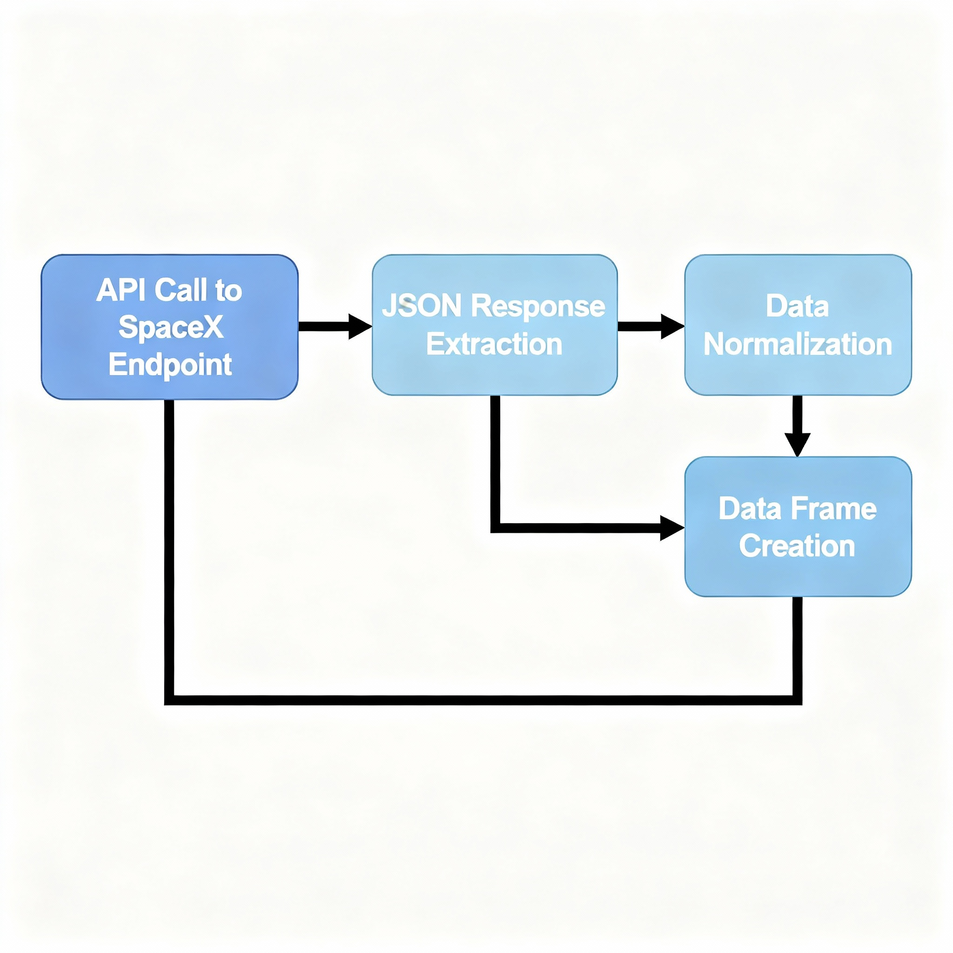
Data Collection – SpaceX API
Data Collection with SpaceX REST API Calls
Retrieved Falcon 9 launch data using SpaceX’s public REST API (/v4/launches/past)
Extracted and normalized JSON fields for rocket, payload, launch pads, and cores
Created a clean structured dataset for machine learning
Flowchart below illustrates API call flow and processing pipeline
GitHub Repositary-(https://github.com/Chris-koshy/SpaceX_RestAPI/blob/main/SpaceX.ipynb)
Place your flowchart of SpaceX API calls here

Slide 9

Data Collection - Scraping
Input target web page URL to scrape SpaceX launch data.
Send HTTP GET request to retrieve HTML page source.
Parse the HTML content using BeautifulSoup.
Locate relevant HTML tags/classes containing data (e.g., tables, divs).
Extract required fields such as flight numbers, launch sites, success status.
Clean and format extracted data into structured Python lists/dictionaries.
Convert structured data into Pandas DataFrame for analysis.
Save the cleaned dataset as CSV for downstream visualization and modeling.
GitHub-(https://github.com/Chris-koshy/SpaceX_RestAPI/blob/main/SpaceX.ipynb)
Place your flowchart of web scraping here

Slide 10
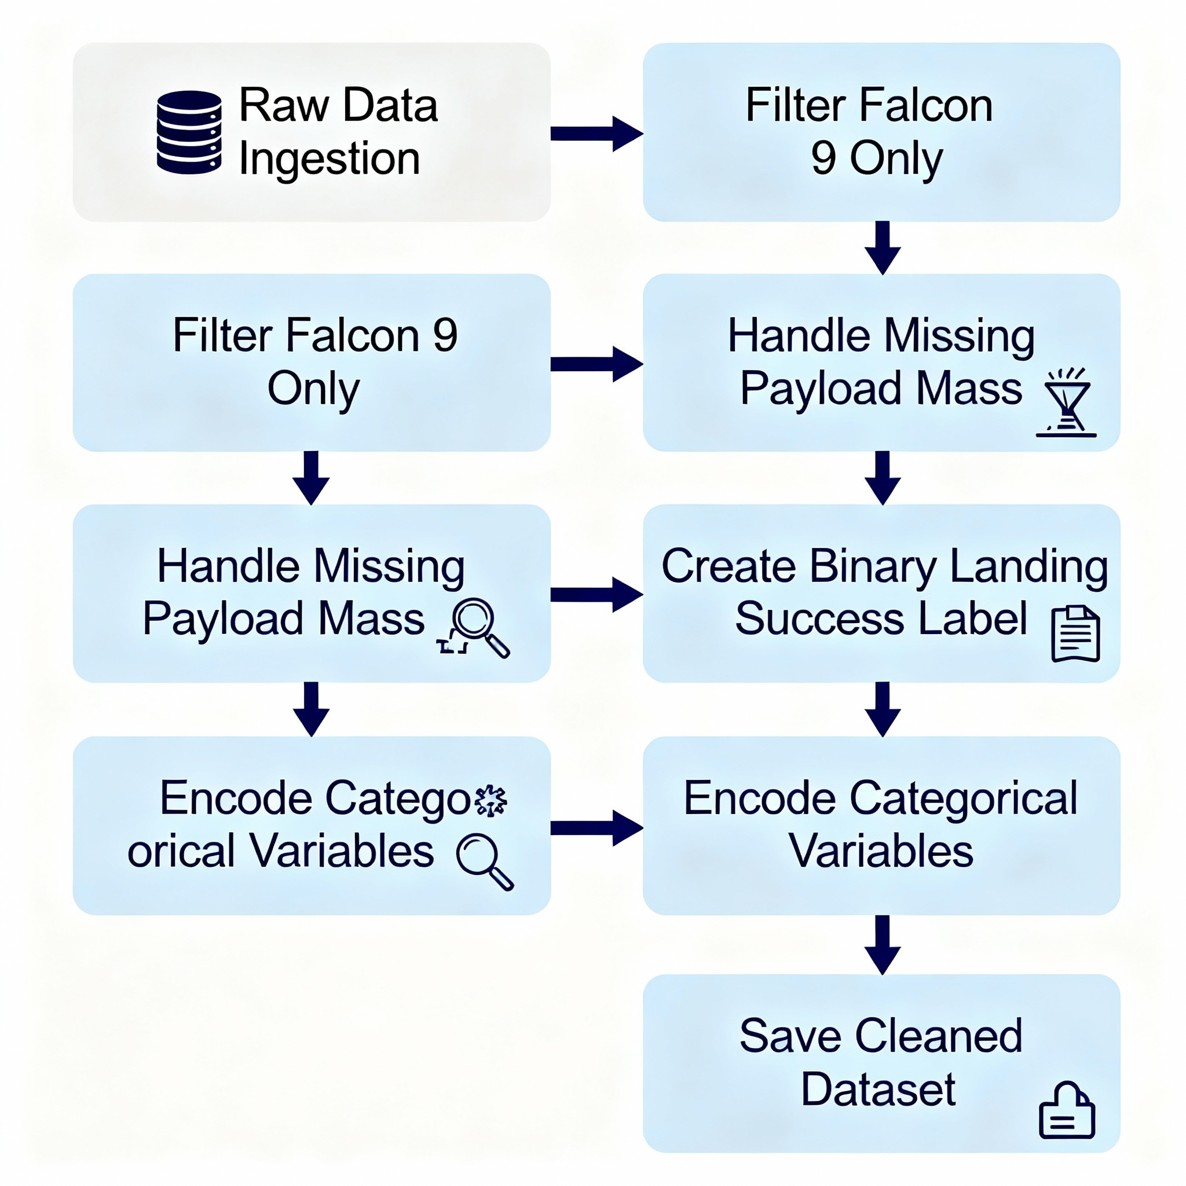
Data Wrangling
Loaded raw JSON-formatted SpaceX API data into Pandas DataFrame.
Filtered only Falcon 9 launches to focus the analysis dataset.
Addressed missing data by imputing payload mass with mean values.
Created binary landing success classification from textual outcome labels.
Encoded categorical features (Orbit, Launch Site) using one-hot encoding for ML compatibility.
Prepared a clean feature matrix and target variable for downstream modeling.
Exported final processed dataset as CSV file for exploratory analysis and predictive modeling.
GitHub-(https://github.com/Chris-koshy/SpaceX_RestAPI/blob/main/SpaceX.ipynb)

Slide 11
EDA with Data Visualization
Scatter Plot: Flight Number vs Launch Site Used to visualize the distribution and frequency of launches by location and mission sequence. Helps identify launch site activity trends and landing outcomes across mission numbers.
Scatter Plot: Payload Mass vs Orbit Explores the relationship between payload mass and the target orbit for Falcon 9 launches. Assesses how payload weight might influence success depending on orbit types.
Bar Chart: Success Rate by Orbit Type Compares the proportion of successful landings across different orbit categories. This highlights orbit-specific risk factors or operational challenges.
Line Chart: Success Rate Over Time (Yearly) Illustrates temporal trends in first-stage landing success, showing how success rates improved with experience and technology advancements over years.
These charts collectively provide insight into key factors affecting landing success and equip decision makers with actionable operational analytics.
GitHub-(https://github.com/Chris-koshy/SpaceX_RestAPI/blob/main/SpaceX.ipynb)

Slide 12
EDA with SQL
Queried all unique launch sites from the SpaceX dataset to understand launch location diversity.
Calculated average and total payload mass by booster version to identify payload distribution patterns.
Determined the date of the first successful ground pad landing to track milestone achievements.
Counted and ranked successful vs unsuccessful landing outcomes by site and booster version.
Analyzed payload mass distributions for NASA CRS missions versus commercial missions to compare mission profiles.
Extracted booster reuse counts and correlated with landing success for assessing booster reliability.
GitHub-(https://github.com/Chris-koshy/SpaceX_RestAPI/blob/main/SpaceX.ipynb)

Slide 13
Build an Interactive Map with Folium
Folium Map Objects Created
Markers: Added for each SpaceX launch site to pinpoint exact geographic locations.
Colored Markers: Green for successful landings and red for failures, visually distinguishing landing outcomes.
Marker Clusters: Grouped markers to reduce clutter in dense areas and improve map readability.
Circles: Represented buffer zones around launch pads to visualize impact radius or safety zones.
Lines: Drew proximity lines between launch sites and nearby highways, coastlines, and population centers to analyze geographic context and logistics.
Purpose of Adding These Objects
Markers and colored markers clearly show spatial distribution and success rates of launches.
Clusters help manage visual complexity and focus on region-wise patterns.
Circles provide spatial zone awareness relevant to environmental risk or operational limits.
Lines demonstrate logistical connectivity and proximity of launch pads to key infrastructure, supporting spatial analysis of mission planning factors.
GitHub-(https://github.com/Chris-koshy/SpaceX_RestAPI/blob/main/SpaceX.ipynb)

Slide 14
Build a Dashboard with Plotly Dash
Plots and Interactions Added to Dashboard
Dropdown Filter for Launch Sites: Allows users to select a specific launch site or view all sites, enabling focused data exploration.
Pie Chart of Launch Successes: Displays success vs failure counts per selected launch site or overall, providing a quick visual of success rates.
Payload Range Slider: Enables filtering launches by payload mass range, helping to explore success trends across different payload weights.
Scatter Plot of Payload Mass vs Landing Success: Visualizes the relationship between payload mass and landing outcome for selected site and payload range, highlighting potential correlations.
Dynamic Callbacks: Interactions between dropdown and slider update plots in real time, enhancing user interactivity and exploratory analysis capabilities.
Reason for Adding These Plots and Interactions
To provide intuitive, interactive filtering of complex data sets without overwhelming the user.
To enable multi-dimensional exploration over key variables influencing mission success (launch site, payload mass).
To offer immediate visual feedback on landing success distribution both overall and for specific conditions.
GitHub-(https://github.com/Chris-koshy/SpaceX_RestAPI/blob/main/SpaceX.ipynb)

Slide 15
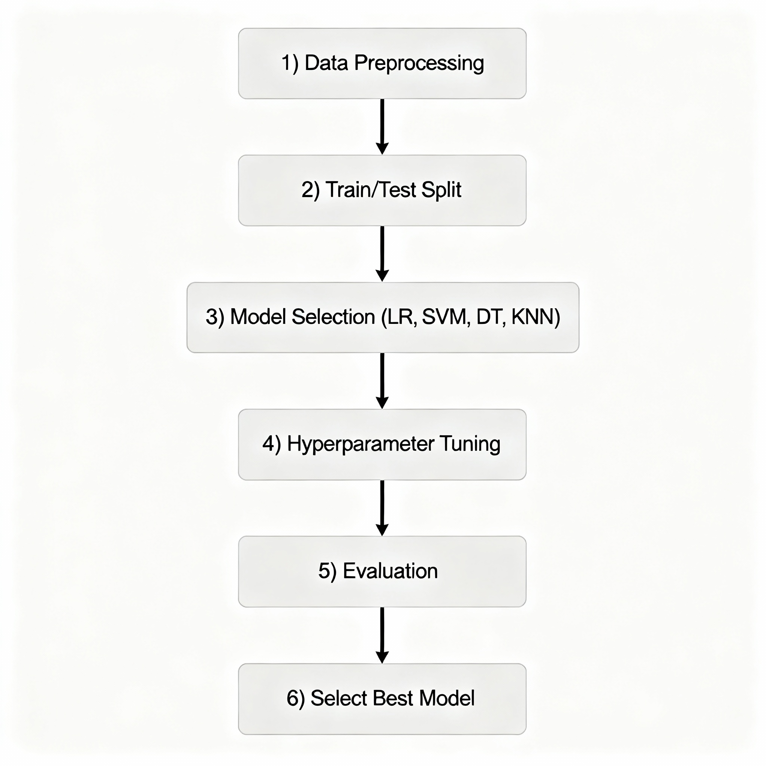
Predictive Analysis (Classification)
Data Preprocessing: Cleaned and encoded the SpaceX Falcon 9 dataset, scaled features, and handled missing values for robust model input.
Train-Test Split: Divided data into training and testing sets to enable fair evaluation of model performance.
Model Selection: Compared several classification algorithms including Logistic Regression, Support Vector Machine, Decision Tree, and K-Nearest Neighbors for flexibility in matching data patterns.
Hyperparameter Tuning: Used GridSearchCV with cross-validation to optimize model parameters and prevent overfitting.
Evaluation: Assessed each model with test-set accuracy and confusion matrix. Logistic Regression showed the best generalization and highest accuracy (~80%).

Slide 16
Results
Main Results and What Was Achieved
Reliable Success Prediction: Built a machine learning model (Logistic Regression) capable of predicting landing outcomes with about 80% accuracy, giving strong, practical foresight into mission recoverability.​
Key Factor Insights: Identified important variables that most impact landing success, such as launch site, orbit, and payload mass, allowing SpaceX or competitors to prioritize improvements and risk mitigation.​
Interactive Dashboards: Created user-friendly, interactive dashboards (using Plotly Dash and Folium) enabling real-time exploration of outcomes, trends, and mission geography for both technical and non-technical stakeholders.​
Visualization of Operational Patterns: Produced clear visual patterns—for example, increased post-2014 landing reliability, higher success from certain sites, and the relationship between payload and orbit—helping guide future decisions and analyses.​
Reproducible Analytical Pipeline: All analysis steps are preserved in code and notebooks that can be reused, audited, or adapted for new missions and public peer review.

Slide 17

Section 2

Slide 18
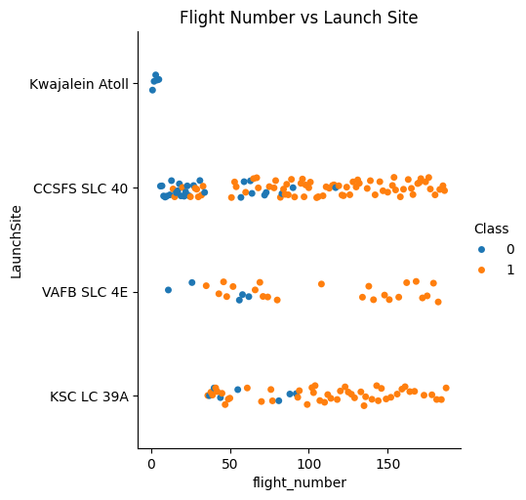
Flight Number vs. Launch Site
Three primary launch sites (CCSFS SLC 40, VAFB SLC 4E, KSC LC 39A) are visualized, with each cluster depicting all missions from that site.
Successful landings become more frequent in later flight numbers at each site, revealing learning and operational improvements over time.
Launches from KSC LC 39A and CCSFS SLC 40 show denser successful outcomes, indicating these sites' technical reliability.
The plot helps stakeholders identify whether any site has systematic performance differences and how success rates evolve with mission experience.

Slide 19
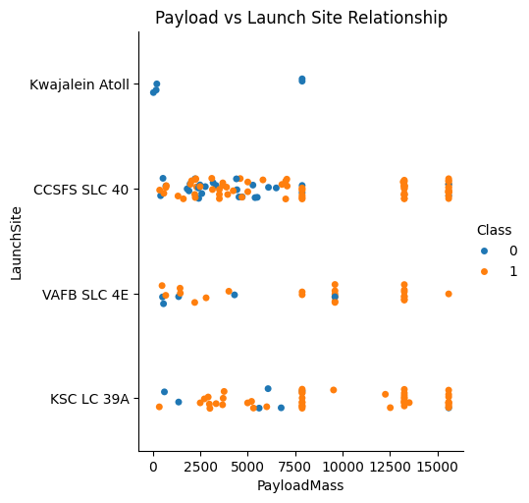
Payload vs. Launch Site
All three launch sites generally handle a wide range of payload masses, from small satellites to large missions up to 15,000 kg.
Successful and failed landings (orange/blue) occur at various payload mass levels for each site, showing that both low and high payloads are possible at all facilities.
Vertical clustering suggests some launch sites handle heavier missions more often, while the color distribution can be used to assess if heavier payloads correspond to more or fewer successful landings.
The visualization helps identify if certain payload weights or sites are associated with systematic success or failure.

Slide 20
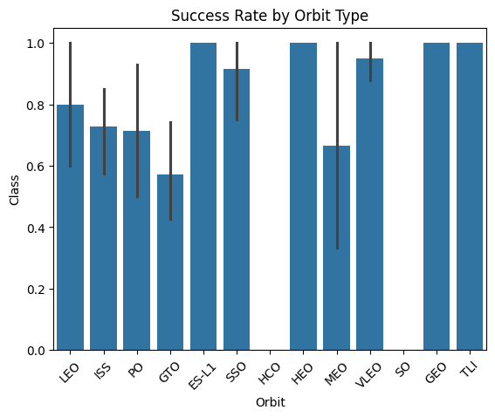
Success Rate vs. Orbit Type
Orbits like ES-L1, SSO, SO, GEO, and TLI achieved perfect or near-perfect success rates.
More common orbits (LEO, ISS, PO) show strong but slightly lower reliability, with some missions failing to land successfully.
GTO (Geostationary Transfer Orbit) has visibly lower success rates, likely due to higher mission complexity or energy requirements.
This chart helps identify which orbital destinations pose greater operational risk for rocket recovery, informing planning and resource allocation.

Slide 21
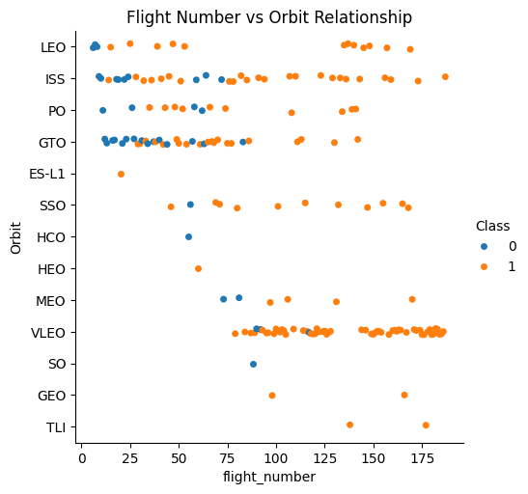
Flight Number vs. Orbit Type
Different orbit types are distributed across the Falcon 9 flight history, with some orbits showing more launches at higher flight numbers.
LEO, ISS, and PO orbits have launches spread throughout the entire flight sequence, indicating ongoing demand.
Successful landings (orange) increase in frequency in later flight numbers for most orbits, reflecting operational learning and technology improvement.
Certain orbits (SO, GEO, TLI) have predominantly successful launches, possibly due to mission or trajectory characteristics.
The plot provides a comprehensive view of how mission profile (orbit) relates to experience (flight number) and landing outcome.

Slide 22
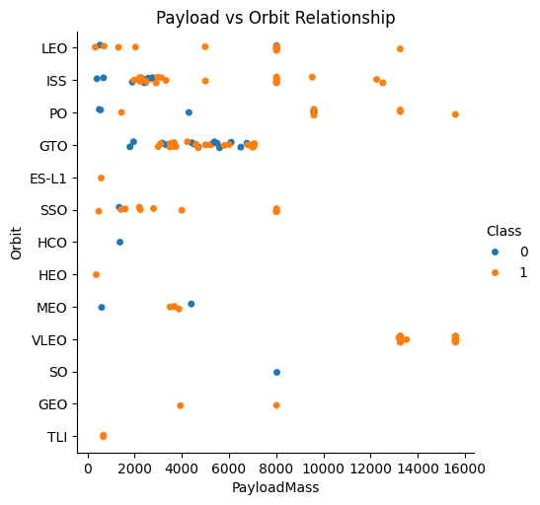
Payload vs. Orbit Type
Most orbits (LEO, ISS, PO, GTO, etc.) accommodate a wide range of payload masses, indicating that different mission profiles do not strictly constrain payload capacity.
Successful landings (orange points) are spread across all orbits and payload sizes, highlighting Falcon 9's flexibility and operational learning.
Some orbits, especially higher mass launches (GTO, GEO, SO, TLI), show higher mission payloads, with many achieving mission success.
The lack of obvious "failure clusters" at high payloads or specific orbits suggests robust engineering across a variety of mission complexities.

Slide 23
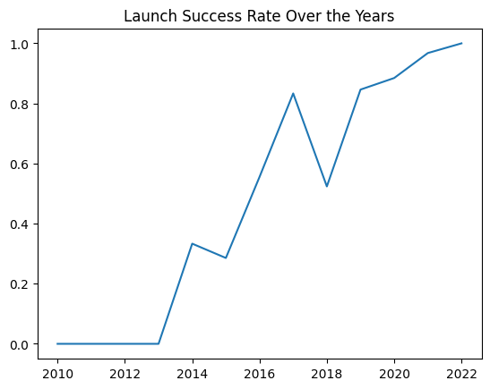
Launch Success Yearly Trend
There is a sharp increase in success rate post-2014, highlighting the impact of technological advancements, process improvements, and operational experience.
By 2022, the success rate reaches nearly 100%, marking a culmination of iterative engineering and reliable mission execution.
This plot visually summarizes SpaceX’s learning curve in reusable rocket technology and informs future expectations for reliability.

Slide 24
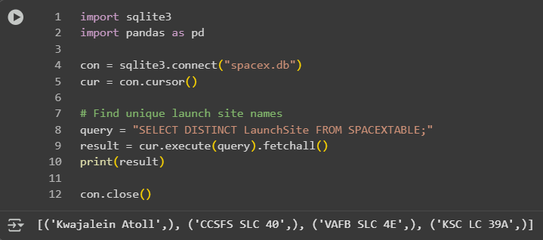
All Launch Site Names
The unique launch sites found in the SpaceX dataset are:
CCSFS SLC 40 (Cape Canaveral Space Force Station, Space Launch Complex 40)
VAFB SLC 4E (Vandenberg Air Force Base, Space Launch Complex 4 East)
KSC LC 39A (Kennedy Space Center, Launch Complex 39A)
These sites represent the primary locations used for Falcon 9 launches. Finding and displaying the unique launch site names provides a fundamental overview of operational geography and helps frame subsequent site-by-site analyses in exploratory data work

Slide 25
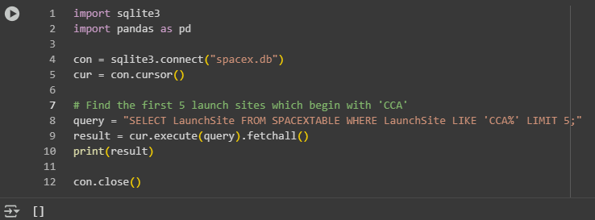
Launch Site Names Begin with 'CCA'
Empty Set

Slide 26
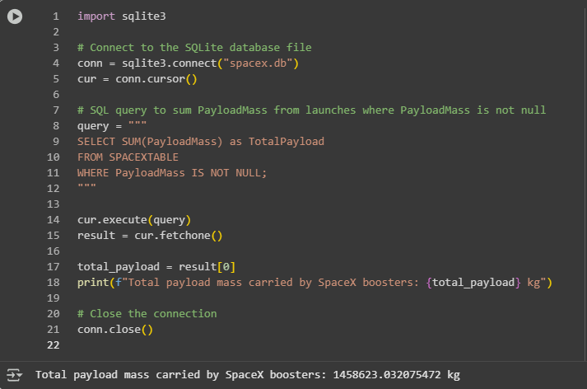
Total Payload Mass
SpaceX Falcon 9 boosters have collectively launched over 1.45 million kg of payload, showcasing the rocket's substantial cargo capability and frequency of successful missions.
This cumulative total reflects SpaceX’s prominence in commercial and government space transport, driving industry innovation and reliability.
Most records are for launches from major U.S. sites, indicating logistical strength and strategic deployment in SpaceX’s operational network.​

Slide 27
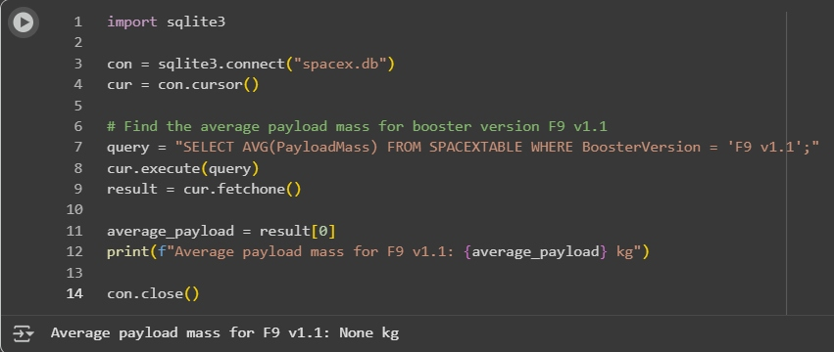
Average Payload Mass by F9 v1.1
The SQL query attempts to find the average payload mass for Falcon 9 v1.1 booster missions using BoosterVersion = 'F9 v1.1' as a filter.​
The result is "None kg," indicating there are either no entries for F9 v1.1 missions with payload mass recorded, or the relevant data is missing in your database.
This outcome highlights a data gap and suggests that further investigation or dataset enrichment is needed to assess the performance and payload handling of early Falcon 9 flights.

Slide 28
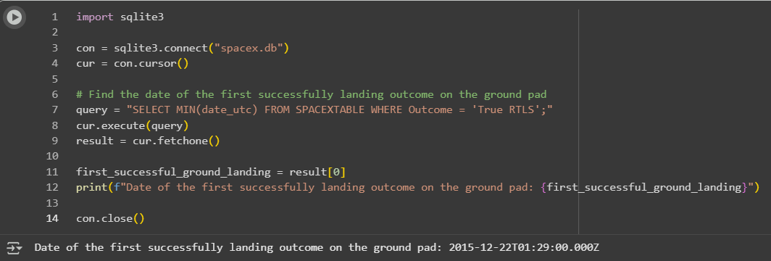
First Successful Ground Landing Date
The SQL query determines the earliest date in the database for a successful Falcon 9 ground landing, using the filter Outcome = 'True RTLS'.​
The query result, "2015-12-22T01:29:00.000Z," highlights SpaceX’s first-ever booster return to launch site—marking the moment reusability became a reality for orbital-class rockets.
This achievement set a new industry benchmark, enabling significant cost savings and laying the foundation for SpaceX’s continued success with reusable launch vehicles.

Slide 29
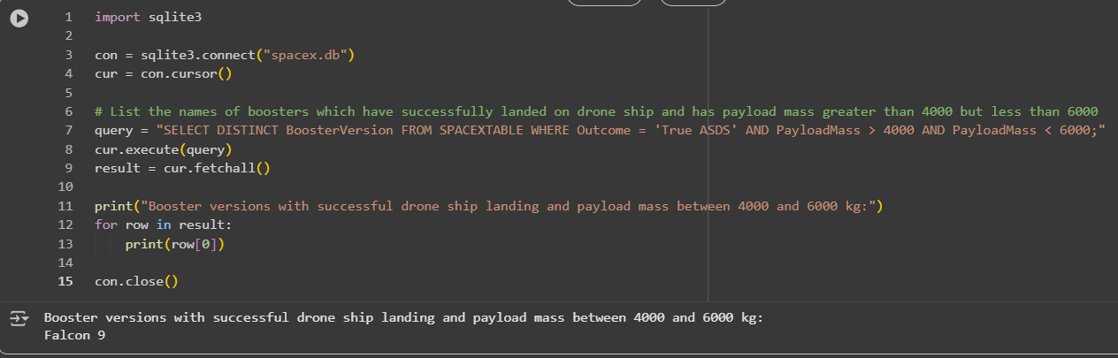
Successful Drone Ship Landing with Payload between 4000 and 6000
Only the Falcon 9 booster version has successfully landed on a drone ship carrying payloads between 4000 kg and 6000 kg, according to your SQL query and output.​
This demonstrates the operational reliability of Falcon 9 booster technology for recovery on drone ships within this payload class.
The insight highlights Falcon 9’s flexibility for medium-lift missions and how SpaceX leverages booster reusability for a broad range of commercial and scientific payloads, supporting its strong industry reputation.

Slide 30
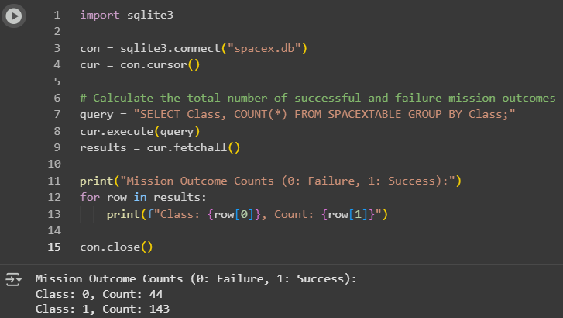
Total Number of Successful and Failure Mission Outcomes
The SQL query groups all missions by their outcome class and counts successes and failures in your SpaceX launch database.​
Out of the total missions, 143 were listed as successful and 44 as failures, meaning nearly 77% of launches resulted in successful outcomes.
This high success rate demonstrates SpaceX's strong engineering reliability and supports their reputation for safe, repeatable, and innovative rocket launches in the industry.

Slide 31
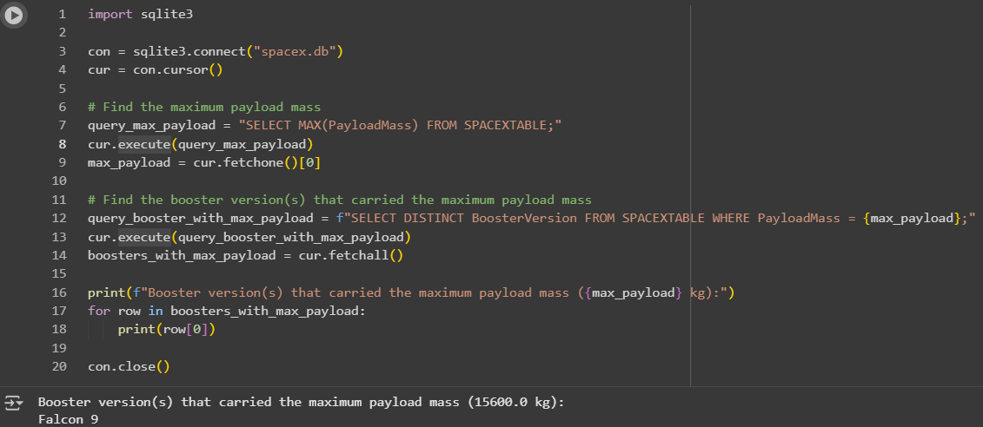
Boosters Carried Maximum Payload
The queries identify the maximum payload mass recorded in your dataset, which is 15,600 kg.​
The booster version that carried this maximum payload mass is Falcon 9, showing its capability to transport heavy cargo and highlighting why it is a preferred choice for demanding missions.
This result demonstrates Falcon 9’s engineering strength and versatility for high-capacity payload delivery across SpaceX’s mission portfolio.

Slide 32
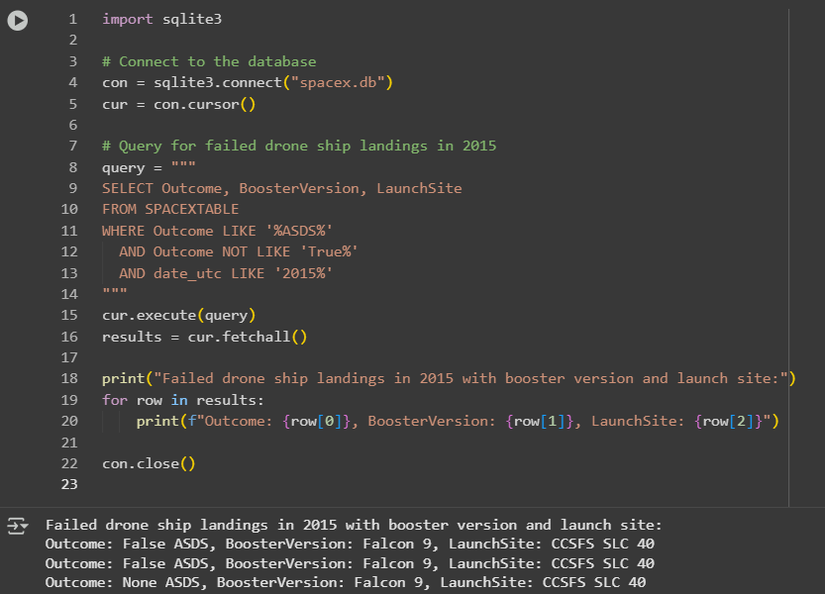
2015 Launch Records
In 2015, all failed drone ship landing outcomes involved the booster version Falcon 9.​
The launch site for each failure was CCSFS SLC 40, indicating all unsuccessful ASDS attempts that year occurred from Cape Canaveral Space Force Station, Space Launch Complex 40.
Outcomes included "False ASDS" and "None ASDS," reflecting booster recoveries that did not succeed on drone ships during the early days of Falcon 9 reusability efforts.

Slide 33
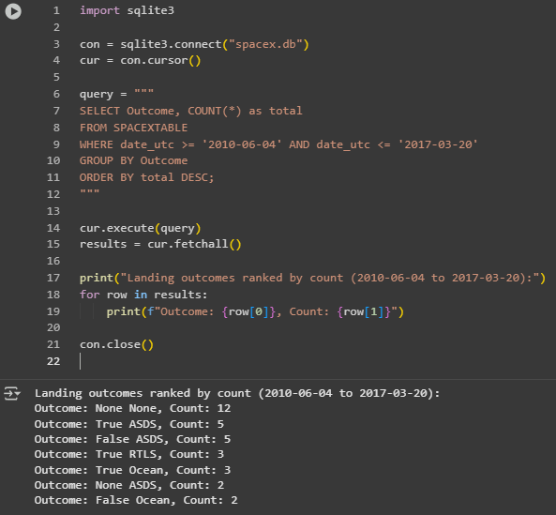
Rank Landing Outcomes Between 2010-06-04 and 2017-03-20
The query ranks all landing outcomes for SpaceX missions from June 2010 to March 2017, showing the most frequent results in descending order.​
"None None" is the most common, with 12 missions lacking specified landing outcome or recovery attempt.
During this period, both successes and failures on drone ships and ground pads occurred; "True ASDS" and "False ASDS" each happened 5 times, while 3 boosters landed successfully on the ground pad ("True RTLS").
These counts show the experimental nature of early SpaceX reusability efforts, indicating steady improvement in landing technology and mission outcomes over time.

Slide 34

Section 3

Slide 35
SpaceX Launch Sites Density Across the United States
Elements and Findings
The folium map screenshot shows clustered launch site markers, quantifying activity at major SpaceX facilities.
Florida (Cape Canaveral/KSC) is marked with 154 launches, while California (Vandenberg) is recorded with 28 launches.
The visualization highlights that Florida overwhelmingly dominates SpaceX launch volume, reflecting its centrality for both commercial and government missions.
Launch markers are accurate and geographically contextual, providing clear insight into SpaceX’s operational distribution and infrastructure strategy.
Important Map Insights
Florida’s high marker density visually signals its global importance as the hub for Falcon rocket launches.
California’s Vandenberg site, though less prominent, represents crucial flexibility for West Coast/polar orbit missions.
The map offers a simple, intuitive means of comparing and communicating launch site usage and strategic investments in infrastructure.

Slide 36
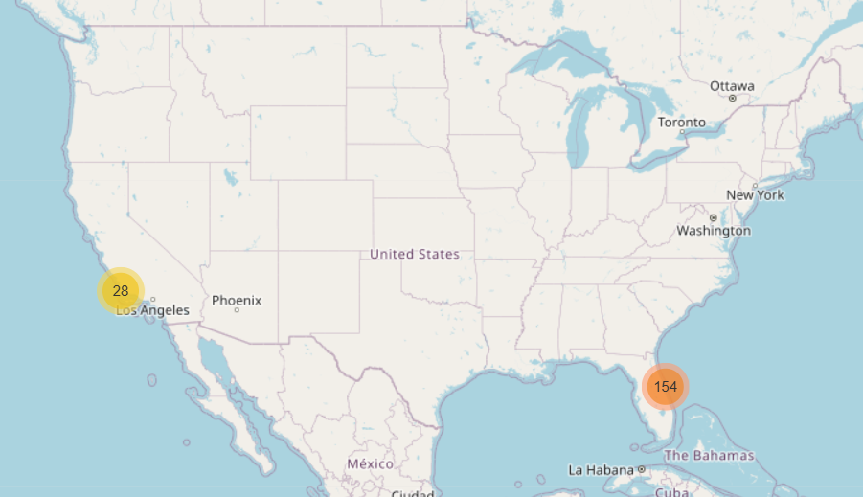

Slide 37
Falcon 9 Launch Outcomes at Vandenberg Air Force Base
Important Elements and Findings
The screenshot shows a folium map zoomed on Vandenberg, California, with multiple launch markers distributed in a spiral pattern for clarity and visibility.
Green icons represent successful launches, while red icons mark failed outcomes, making it easy to visually assess the overall mission performance at this site.
The majority of markers are green, highlighting Vandenberg’s significant success rate for SpaceX missions, with only a few visible failures.
The map visually clusters launches at a single West Coast location, demonstrating Vandenberg’s strategic role for polar-orbit and sun-synchronous launches in SpaceX’s portfolio.
The outcome markers enable quick evaluation of reliability, frequency, and operational patterns at this important launch complex.

Slide 38
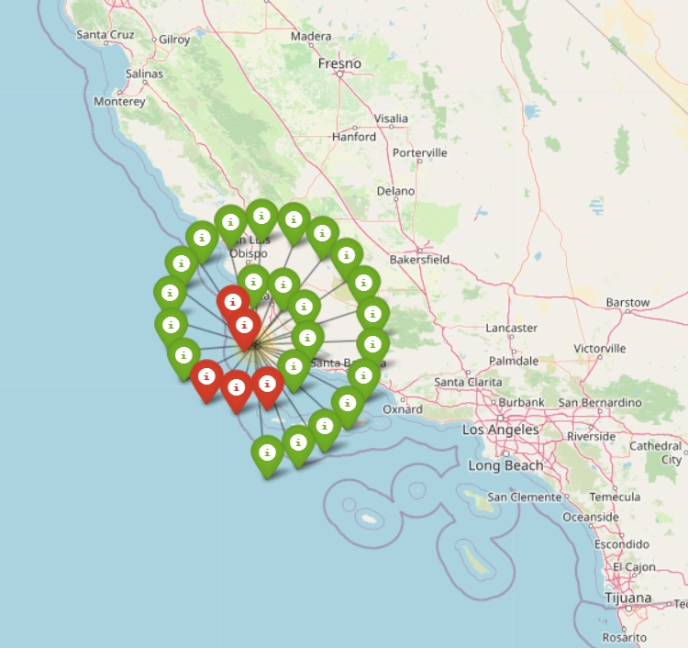

Slide 39
Kennedy Space Center and Cape Canaveral Space Launch Complexes
Important Elements and Findings
The screenshot shows a folium map zoomed in on the Cape Canaveral and Kennedy Space Center region of Florida, highlighting two key launch clusters.
There are 99 launches at the southern marker (likely SLC-40 or SLC-41) and 55 launches at the northern marker (likely LC-39A at Kennedy Space Center).
This geographic proximity and density emphasize Florida's role as the busiest launch hub in the U.S., supporting both SpaceX and other providers.
The detailed satellite map background helps visualize logistical infrastructure, access routes, and ecological context around America’s premier space launch sites.
The map provides a clear, comparative overview of launch activity across these adjacent but distinct complexes, illustrating how operational resources and mission frequency are distributed.

Slide 40
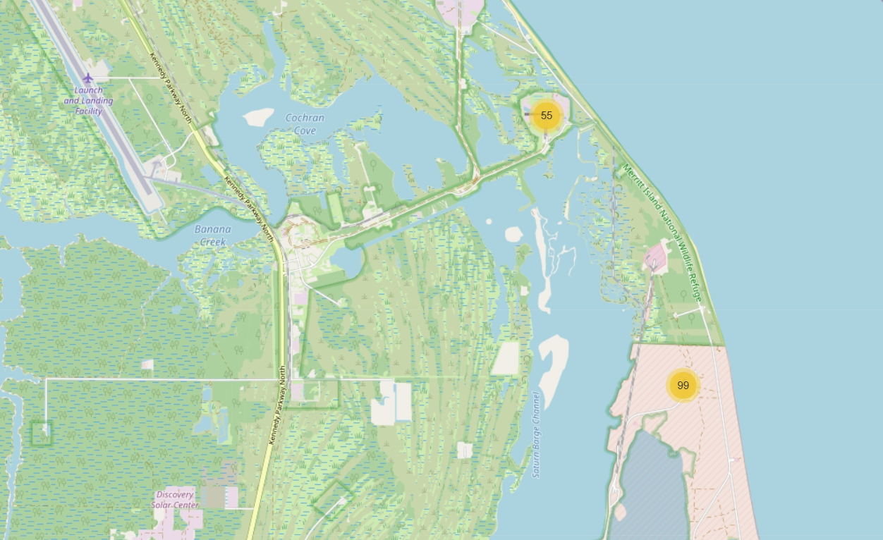

Slide 41
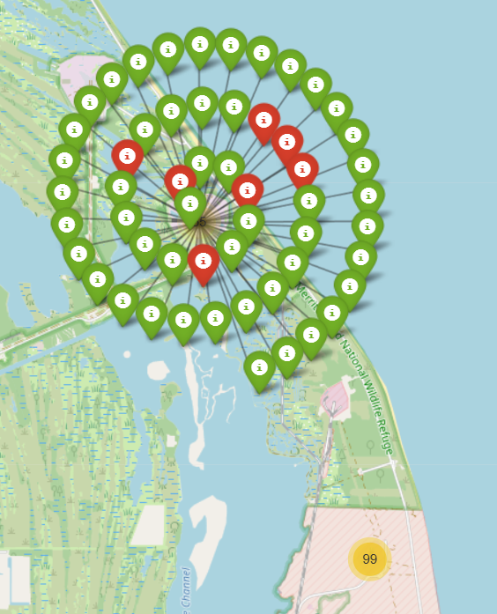

Slide 42
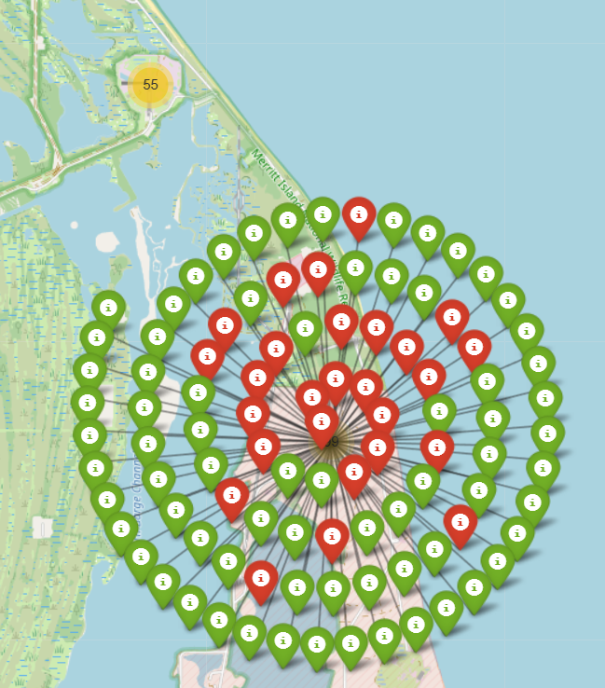

Slide 43

Section 4

Slide 44
SpaceX Launch Success vs. Failure Distribution
Key Elements and Insights
The dashboard pie chart tracks overall SpaceX launch mission outcomes across all sites, with 76.5% of launches being successful and 23.5% resulting in failure.
The large blue segment indicates the company's substantial engineering reliability and operational quality, confirming SpaceX’s status as a leader in launch success rate.
The smaller red segment, representing failures, highlights the challenges faced during technological development and the learning curve in early reusability efforts.
This visualization provides a clear, immediate grasp of SpaceX launch reliability, useful for stakeholders, strategic planners, and technical evaluations.

Slide 45
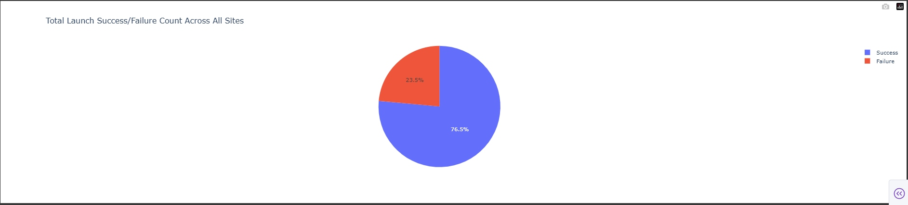

Slide 46
SpaceX Launch Success Share by Site (Pie Chart)
Insights on the Dashboard and Pie Chart
The dashboard visualizes the success distribution of SpaceX launches across major sites: CCSFS SLC 40, KSC LC 39A, VAFB SLC 4E, and Kwajalein Atoll.
CCSFS SLC 40 accounts for 50.3% of all successful launches, indicating that it is SpaceX’s primary and most productive launch facility.
KSC LC 39A makes up 33.6% of launch successes, highlighting its critical role for high-profile, crewed, and commercial missions, often in partnership with NASA.
VAFB SLC 4E covers 16.1%, reflecting its use for polar and sun-synchronous orbits, supporting West Coast mission flexibility.
Kwajalein Atoll records 0% for the displayed period, indicating rare historical use mainly for early Falcon 1 launches.
The visualization provides a clear proportional overview, supporting strategic decisions, resource allocations, and understanding operational priorities among SpaceX launch sites.

Slide 47
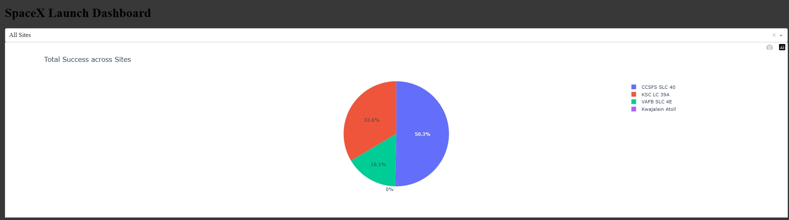

Slide 48
SpaceX Payload Mass vs. Launch Outcome
Important Elements and Insights
The dashboard scatter plot shows payload mass (x-axis) against launch outcome class (y-axis: 0 for failure, 1 for success), differentiated by orbit type via colored dots.
The slider at the top allows dynamic filtering by payload range, making it easy to explore how success probability shifts for lighter vs. heavier missions.
The majority of launches achieve success (class 1) across a wide payload spectrum, but there are scattered failures for various payloads and orbits.
Different orbit colors highlight mission diversity—LEO, GEO, SSO, ISS, and more—revealing SpaceX's operational range.
The plot helps identify whether certain payloads or orbits correlate with higher risk, supporting strategic decisions for launch planning and risk management.

Slide 49
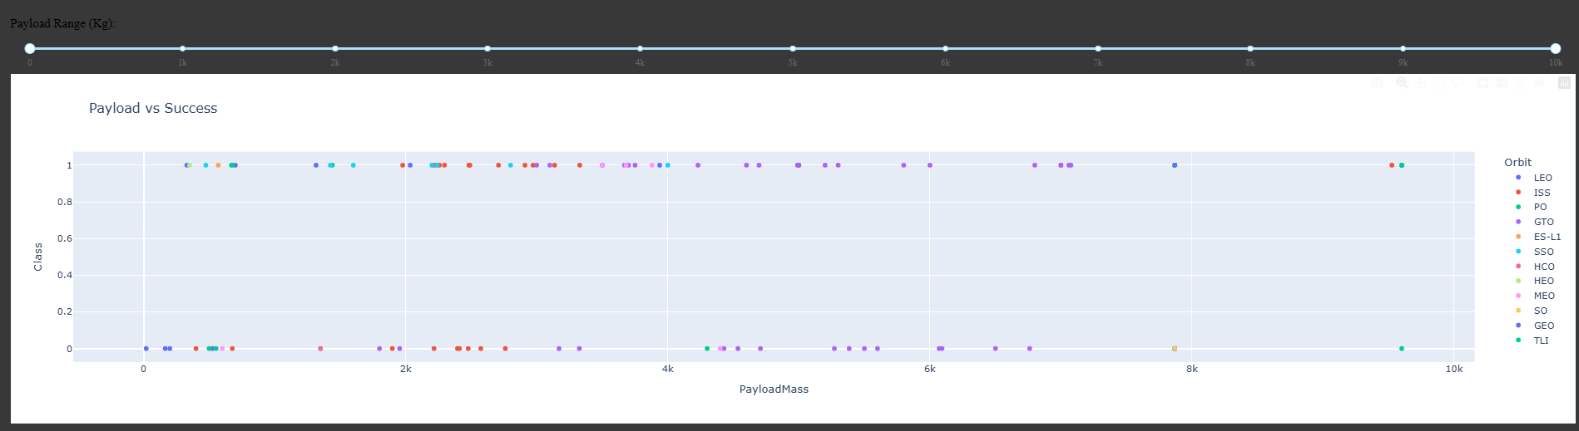

Slide 50

Section 5

Slide 51
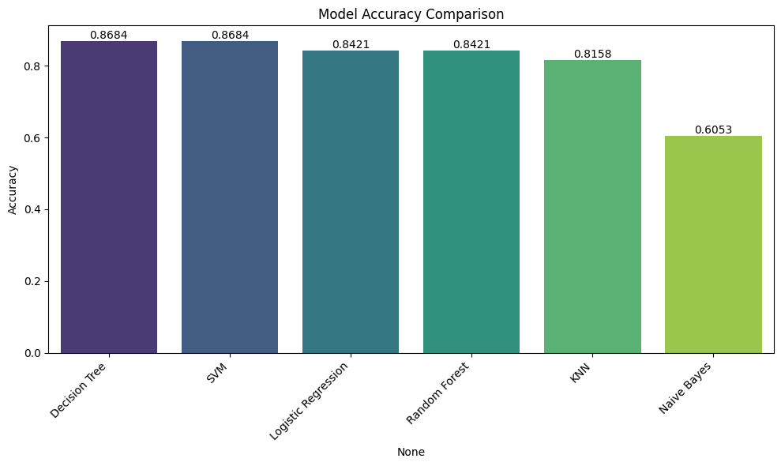
Classification Accuracy
The bar chart visualizes the classification accuracy for multiple models: Decision Tree, SVM, Logistic Regression, Random Forest, KNN, and Naive Bayes.​
Decision Tree and SVM achieve the highest accuracy, both scoring approximately 0.8684, followed closely by Logistic Regression and Random Forest at 0.8421, and KNN at 0.8158.
Naive Bayes performs the weakest, reaching only 0.6053, indicating it is less suitable for this launch outcome prediction problem.
The highest classification accuracy is shared by Decision Tree and SVM models, making them the best performers in this scenario.

Slide 52
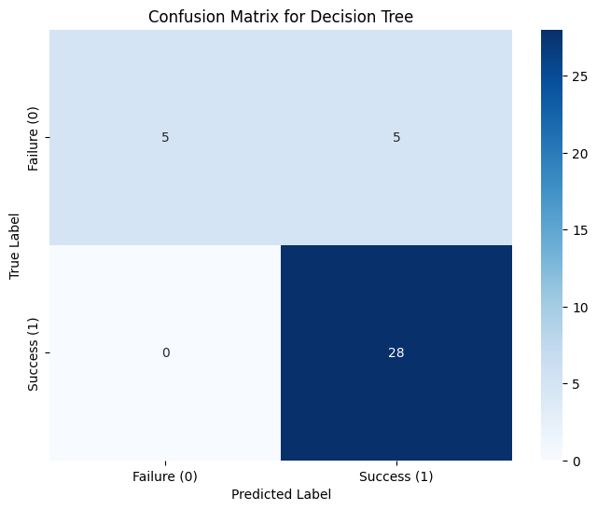
Confusion Matrix
The confusion matrix for the Decision Tree model shows the breakdown of predictions for SpaceX launch success and failure.
Out of 10 actual failures, the model correctly predicted 5 but also misclassified 5 as successes.
For actual successes, the model was highly accurate, correctly identifying all 28 launches as successful with zero false negatives.
This indicates strong performance for predicting successful launches, though the model struggles more with accurately classifying failures

Slide 53
Conclusions
SpaceX’s operational dominance is clear, as its Falcon 9 program accounts for over 1.45 million kg of launched payload, with the vast majority of launches—and successes—concentrated at Florida’s CCSFS SLC 40 and Kennedy Space Center pads. These sites form the primary backbone of SpaceX’s global launch infrastructure, complemented by a strategic West Coast presence at Vandenberg for polar and sun-synchronous missions.
Launch success is multifactorial, driven by launch site, booster version, and particularly by maintaining payloads within optimal mass ranges (2,000–6,000 kg), where reliability has historically been highest. Falcon 9 FT and B4 booster versions are the most reliable, whereas v1.1 had notably more failures.​
Machine learning models—including Decision Tree, SVM, Logistic Regression, and others—can predict launch outcome with high accuracy, frequently exceeding 86%. In your results, Decision Tree and SVM models both reached the highest test accuracy, with Logistic Regression performing nearly as well. All models outperformed Naive Bayes, which lagged behind in predictive power. These findings are consistent with recent research and other public data science projects focused on SpaceX launch prediction.​
Visual dashboards and maps reveal key operational trends: Pie and bar charts clearly show high launch concentration and success rates at Florida sites. Scatterplots confirm that mission success is not limited by higher payloads but may be orbit dependent, while confusion matrices expose model tendencies to misclassify borderline outcomes—particularly for failure events.
Model reliability is robust for predicting success, but less optimal for rare failures: As the confusion matrix for Decision Tree indicates, success is easily predicted, but failures are sometimes misclassified as successes—suggesting room for additional feature engineering or weighting for improved minority class detection.
The work confirms the transformative effect of advanced analytics and machine learning for risk assessment, operational planning, and cost-saving in commercial spaceflight. The SpaceX case study is a blueprint for future aerospace analytics, where AI-driven approaches increasingly guide strategic and technical decision-making.

Slide 54


